Slide 1


Advanced Object-Oriented Programming (C#)
Design Patterns

Slide 2
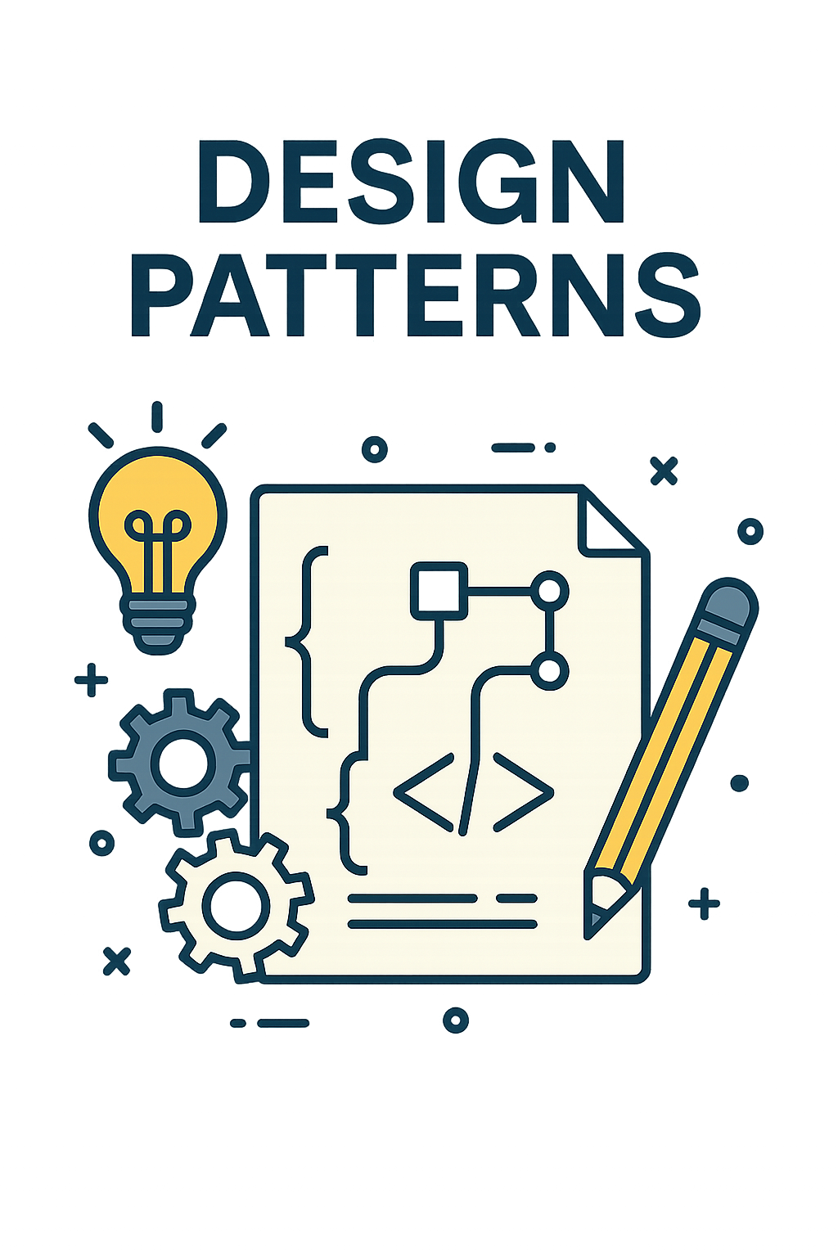
What Are Design Patterns?
Design patterns are typical solutions to commonly occurring problems in software design. They serve as pre-made blueprints that you can customize to solve recurring design issues in your code. Unlike specific code snippets or libraries, design patterns are general concepts that provide a high-level description of a solution, allowing for flexibility in implementation across different programs.
Components of Design Patterns:
Each design pattern typically includes the following components:
Intent: A brief description of the pattern's purpose and the problem it addresses.
Motivation: An explanation of the problem and how the pattern provides a solution.
Structure: Diagrams or descriptions showing the pattern's components and their relationships.
Code Examples: Sample implementations in various programming languages to illustrate the pattern in practice.

Slide 3
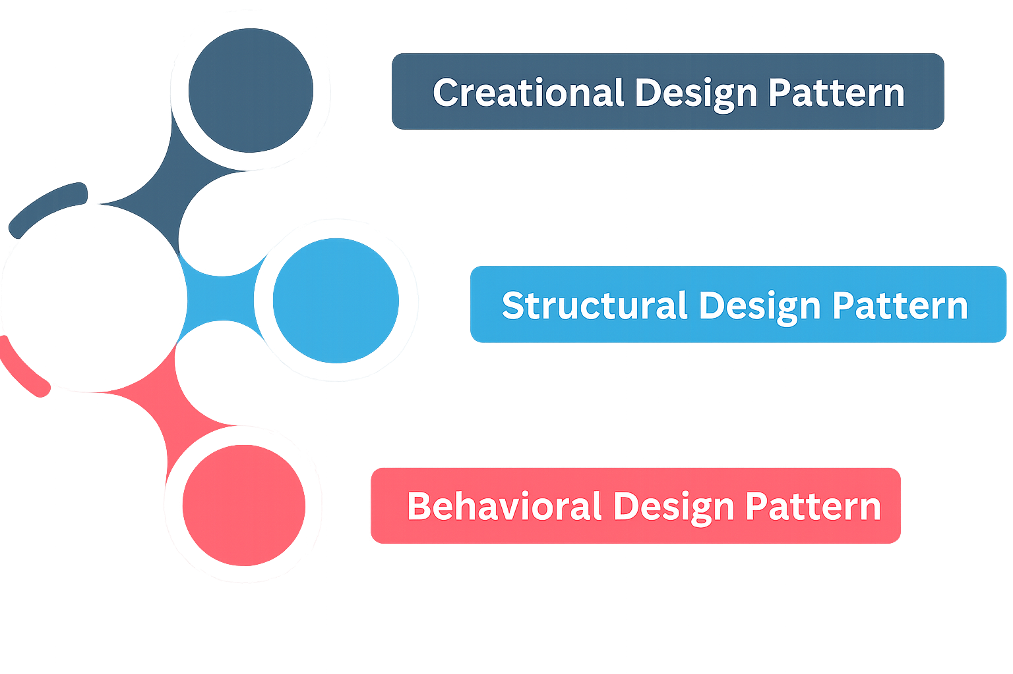
Categories of Design Patterns
Creational Patterns:
These patterns provide various object creation mechanisms, which increase flexibility and reuse of existing code.
Structural Patterns:
These patterns explain how to assemble objects and classes into larger structures while keeping these structures flexible and efficient.
Behavioral Patterns:
These patterns are concerned with algorithms and the assignment of responsibilities between objects.
Type | Purpose | Example Patterns
Creational | Deal with object creation | Factory, Singleton
Structural | Deal with class/object composition | Adapter, Decorator, Proxy
Behavioral | Deal with object interaction | Strategy, Observer, Command

Slide 4
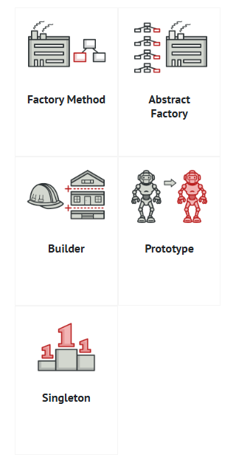
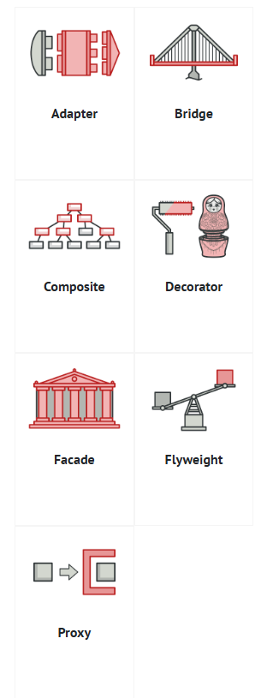
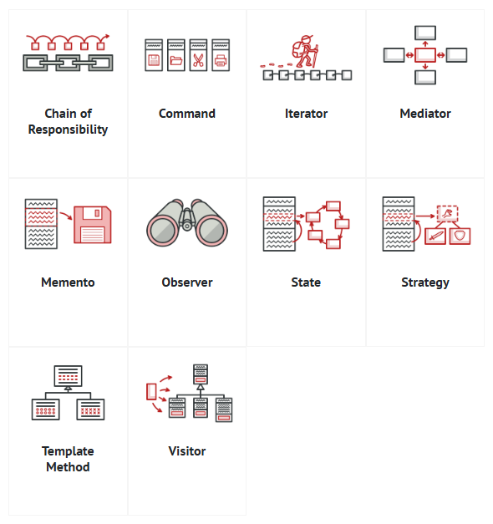
Continued…
Creational
Structural
Behavioral

Slide 5
What will we be covering?
In this module, we’ll cover:
🔨 Factory (Creational)
🧍 Singleton (Creational)
🔁 Strategy (Behavioral)
🗄️ Repository (Layered architecture)

Slide 6
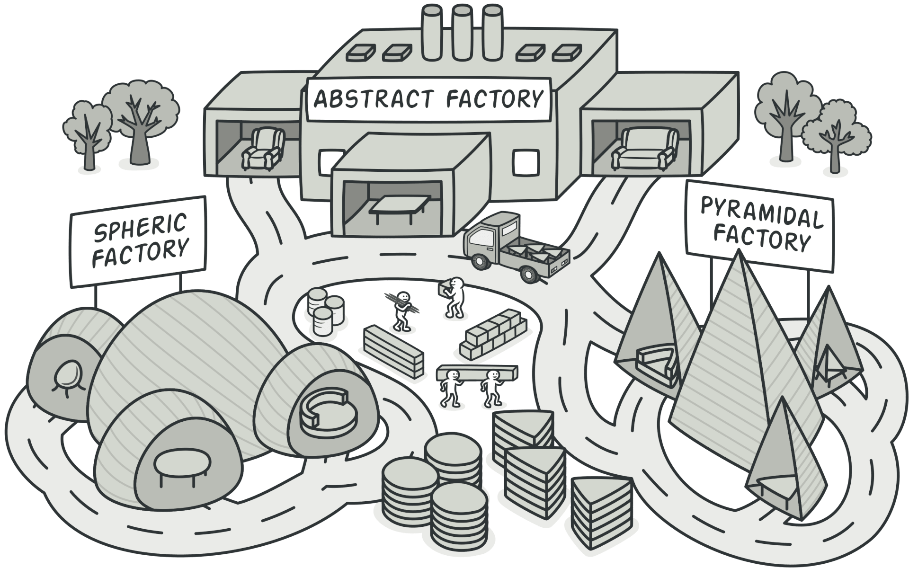
Factory Pattern
The Factory Pattern is a creational design pattern that provides an interface for creating objects, but lets subclasses alter the type of objects that will be created.

Slide 7
Factory Pattern Continued..
public interface ITransport
{
void Deliver();
}
public class Truck : ITransport
{
public void Deliver() => Console.WriteLine("Delivering by land in a box.");
}
public class Ship : ITransport
{
public void Deliver() => Console.WriteLine("Delivering by sea in a container.");
}
public abstract class Logistics
{
public void PlanDelivery()
{
var transport = CreateTransport();
transport.Deliver();
}
public abstract ITransport CreateTransport();
}
public class RoadLogistics : Logistics
{
public override ITransport CreateTransport() => new Truck();
}
public class SeaLogistics : Logistics
{
public override ITransport CreateTransport() => new Ship();
}

Slide 8
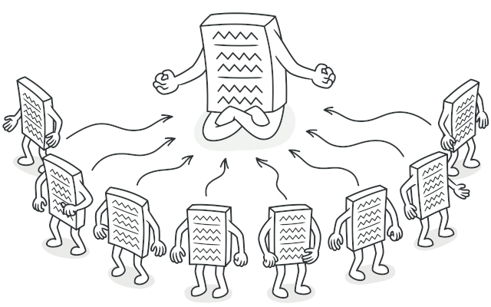
Singleton Pattern
Ensure a class has only one instance and provide a global point of access to it.
public class Mayor
{
private static Mayor _instance;
private static readonly object _lock = new();
private Mayor() { }
public static Mayor Instance
{
get
{
lock (_lock)
{
return _instance ??= new Mayor();
}
}
}
public void IssueCityPolicy(string policy)
{
Console.WriteLine($"Mayor issued policy: {policy}");
}
}

Slide 9
Strategy Pattern
Strategy is a behavioral design pattern that lets you define a family of algorithms, put each of them into a separate class, and make their objects interchangeable.
Step 2: public class NormalTraffic : ITrafficStrategy
{
public void ControlTraffic()
{
Console.WriteLine("Applying normal traffic rules.");
}
}
public class EmergencyTraffic : ITrafficStrategy
{
public void ControlTraffic()
{
Console.WriteLine("Rerouting traffic for emergency.");
}
}
public class EventTraffic : ITrafficStrategy
{
public void ControlTraffic()
{
Console.WriteLine("Redirecting traffic for city event.");
}
}
Step 1: public interface ITrafficStrategy
{
void ControlTraffic();
}
Step 3: public class TrafficController
{
private ITrafficStrategy _strategy;
public void SetStrategy(ITrafficStrategy strategy)
{
_strategy = strategy;
}
public void ExecuteControl()
{
_strategy.ControlTraffic();
}
}

Slide 10
Repository Pattern
The Repository Pattern hides the details of data access behind a clean, easy-to-use interface. It lets you interact with objects, not SQL or database code.
public class Citizen
{
public int Id { get; set; }
public string Name { get; set; }
}
public class InMemoryCitizenRepository : ICitizenRepository
{
private readonly List<Citizen> _citizens = new();
public void Add(Citizen citizen)
{
_citizens.Add(citizen);
}
public Citizen GetById(int id)
{
return _citizens.FirstOrDefault(c => c.Id == id);
}
public IEnumerable<Citizen> GetAll()
{
return _citizens;
}
}
public interface ICitizenRepository
{
void Add(Citizen citizen);
Citizen GetById(int id);
IEnumerable<Citizen> GetAll();
}

Slide 11
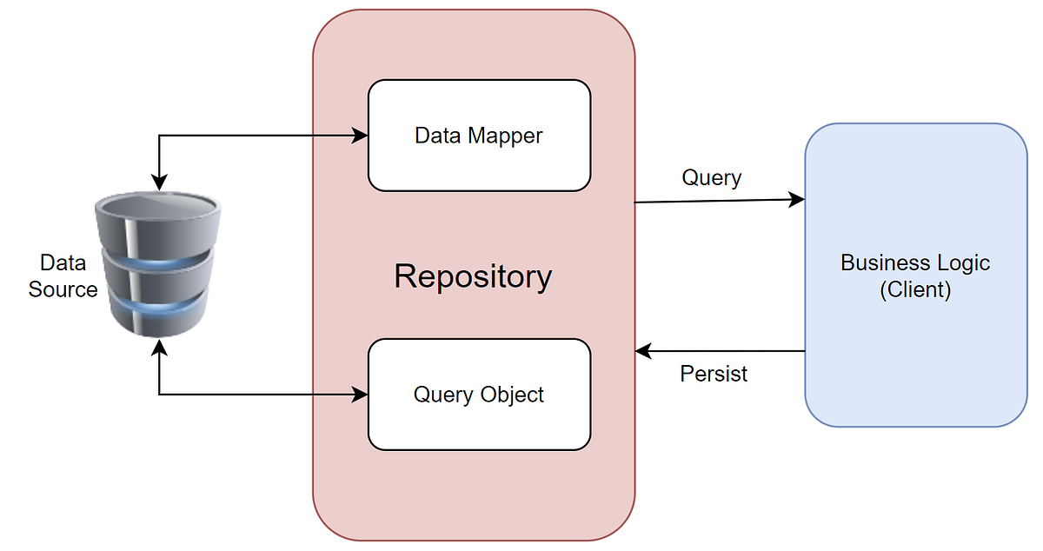
Repository Pattern Continued…
public class CitizenService
{
private readonly ICitizenRepository _repository;
public CitizenService(ICitizenRepository repository)
{
_repository = repository;
}
public void RegisterCitizen(string name)
{
var citizen = new Citizen { Name = name };
_repository.Add(citizen);
Console.WriteLine("Citizen registered.");
}
}

